Slide 1
NETWORKS

Slide 2
Overview
Networks
Network Criteria
Physical structures

Slide 3
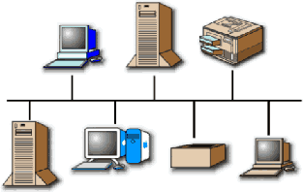
Networks
It is a set of devices (nodes) connected by communication links (media).
Device can be a host (or end system)
Ex: Large computer, desktop, laptop, workstation, cellular
phone, or security system.
Device can also be a connecting device
Router, which connects the network to other networks,
Switch, which connects devices together,
Modem (modulator-demodulator), which changes the form
of data, and so on.
Devices are connected using wired or wireless transmission media such as cable or air.
Most network use distributed processing.

Slide 4
1. Network Criteria

Slide 5
1. Network Criteria
A network must be able to meet a certain number of criteria.
Performance
Reliability
Security

Slide 6
1. Network Criteria cont..
Performance
Measured in many ways, including transit and response time.
Transit time:
Amount of time required for a message to travel from one device to another.
Response time:
Elapsed time between an inquiry and beginning of a
response.

Slide 7
1. Network Criteria cont..
Performance
It depends on a number of factors, including
Number of users
Type of transmission medium
Capabilities of the connected hardware
Efficiency of the software.

Slide 8
1. Network Criteria cont..
Performance
It is evaluated by two contradictory networking metrics:
Throughput
More
Delay
Less
Contradictory : If we try to send more data to the network, we may increase throughput but we increase the delay because of traffic congestion in the network.

Slide 9
1. Network Criteria cont..
Reliability
It is measured by the
Frequency of failure
Time it takes a link to recover from a failure
Network’s robustness in a catastrophe.

Slide 10
1. Network Criteria cont..
Security
Network security issues include
Protecting data from unauthorized access
Protecting data from damage and development
Implementing policies and procedures for recovery from breaches and data losses.

Slide 11
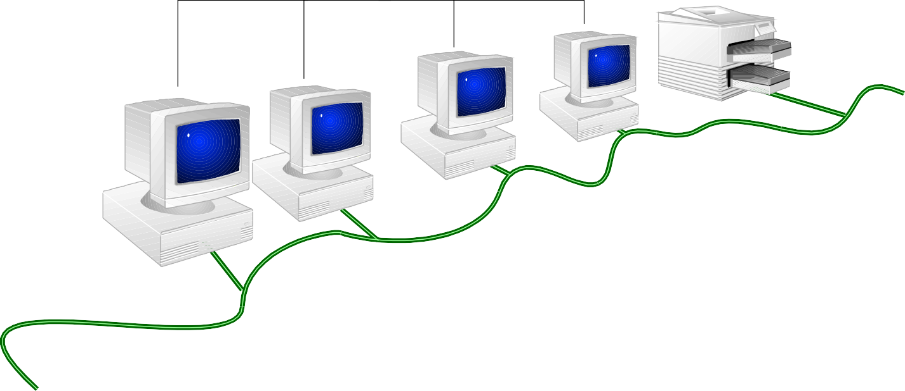
A simple network
Computers
Printer
Cable

Slide 12
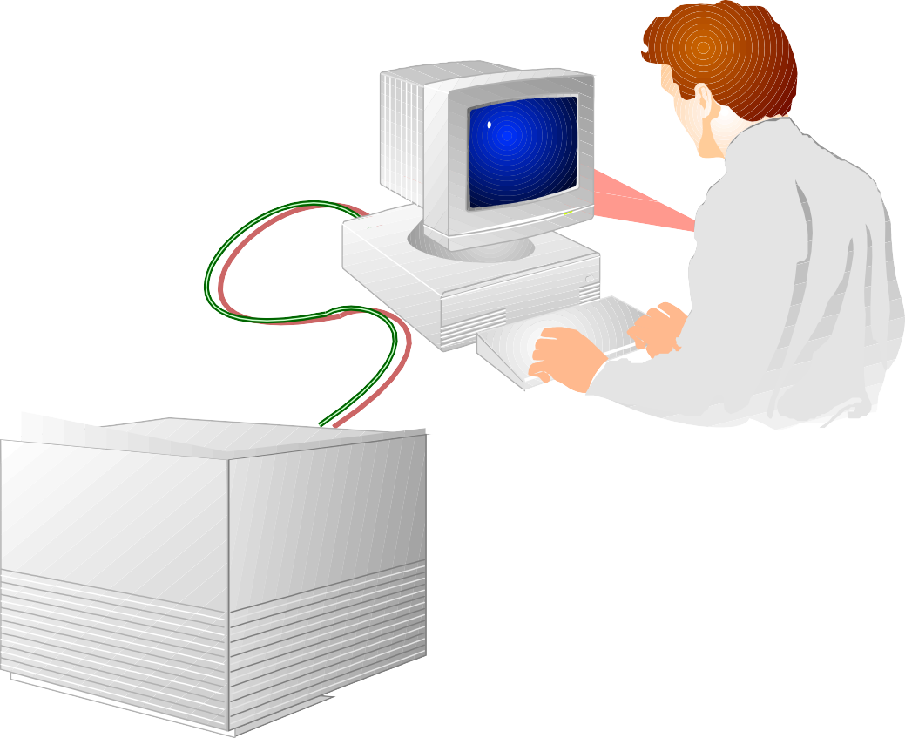
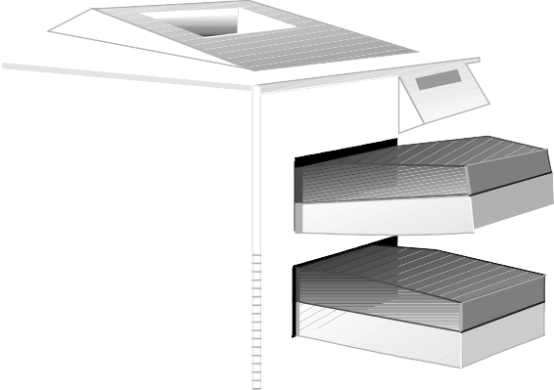
Sharing a printer in a stand-alone environment

Slide 13
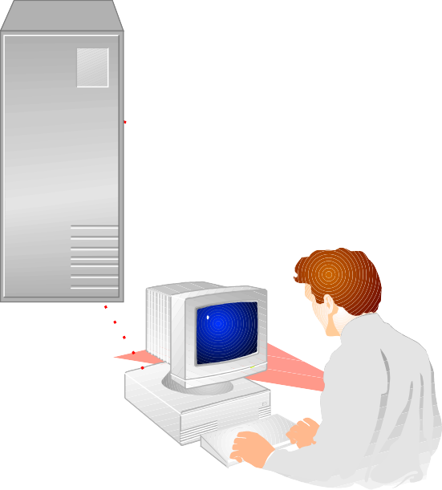
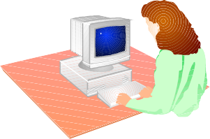

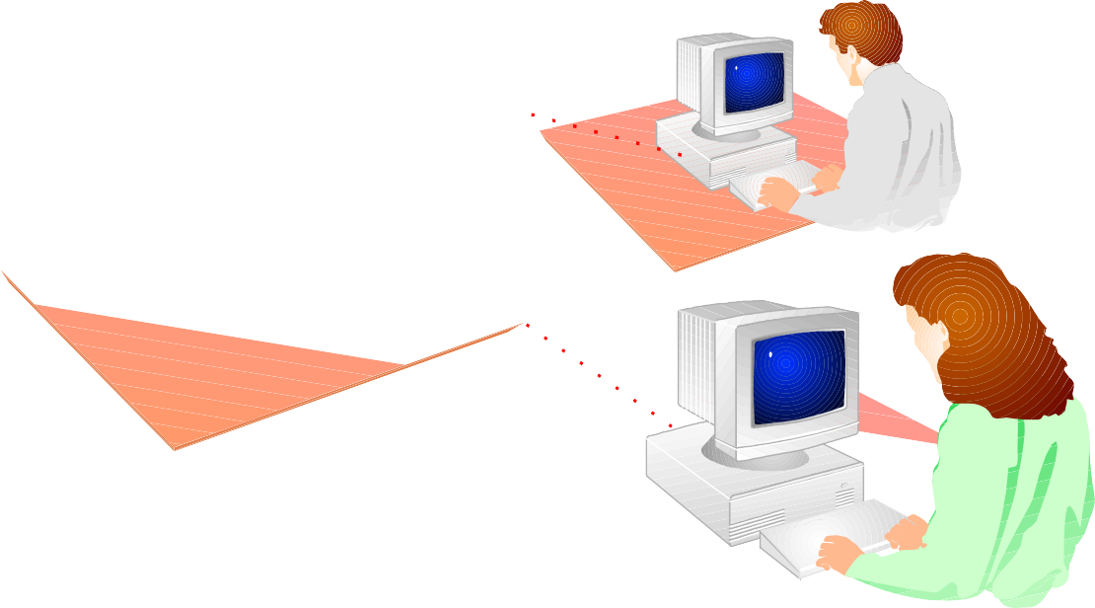
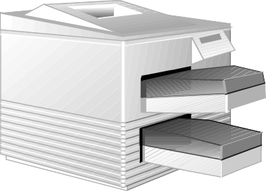
Sharing a printer in a networking environment

Slide 14
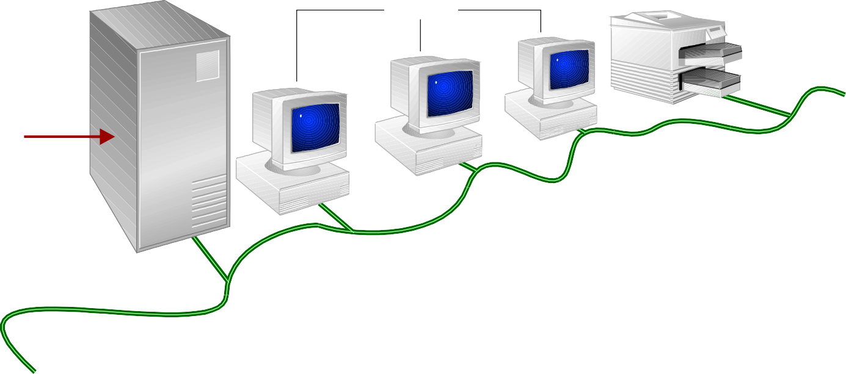
Common network elements
Printer (shared peripherals)
Server
Clients
Data

Slide 15
Applications of Networks
Marketing and sales Ex: online reservation of Hotels
Financial Services Ex: online Banking
Manufacturing Ex: CAD
Electronic Messaging Ex: E-mail
Directory Services Ex: Centralized database
Information Services Ex: Bulletin boards
Tele conferencing Ex: Voice conferencing
Cellular Telephone Ex: Mobile phone communication
Cable Television Ex: Video on Request.

Slide 16
2. Physical Structures

Slide 17
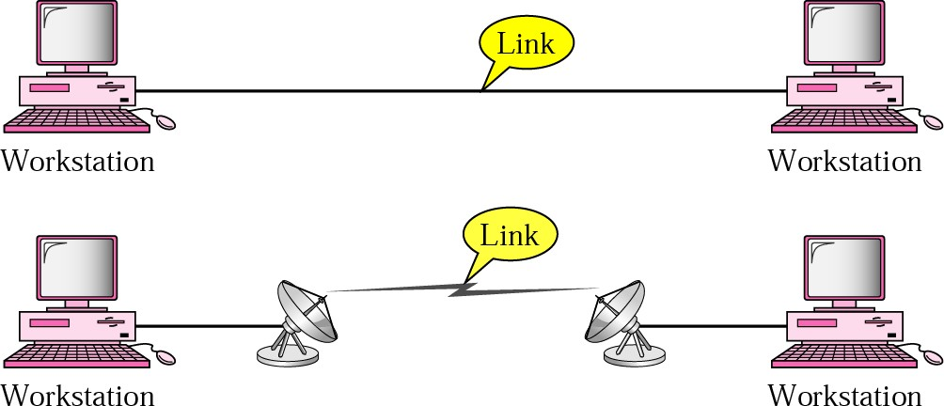
2.1 Type of Connection
Two types of connections: point-to-point and multipoint.
1. Point-to-point
– A dedicated link between two devices.

Slide 18
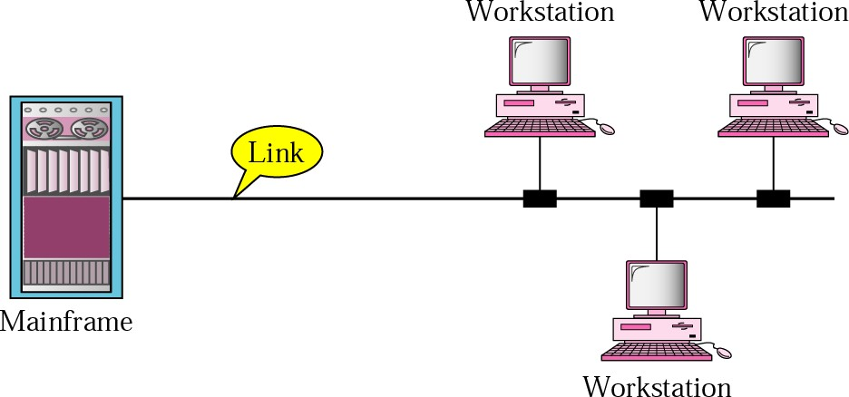
2.1 Type of Connection cont..
2. Multipoint (Multi drop)
– More than two specific devices share a single link.

Slide 19
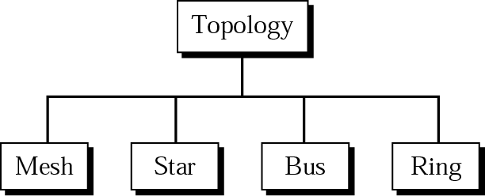
2.2 Physical Topology
Arranging computers in a Network.
Geometric representation of relationship of all the links
and linking devices (usually called nodes) to one another.
There are four basic topologies:
Mesh topology
Star topology
Bus topology
Ring topology

Slide 20
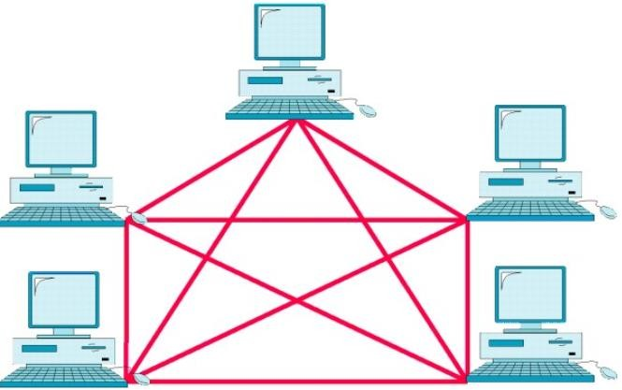
1. Mesh topology
Every link is dedicated point-to-point link
The term dedicated means that the link carries traffic only between the two devices it connects

Slide 21
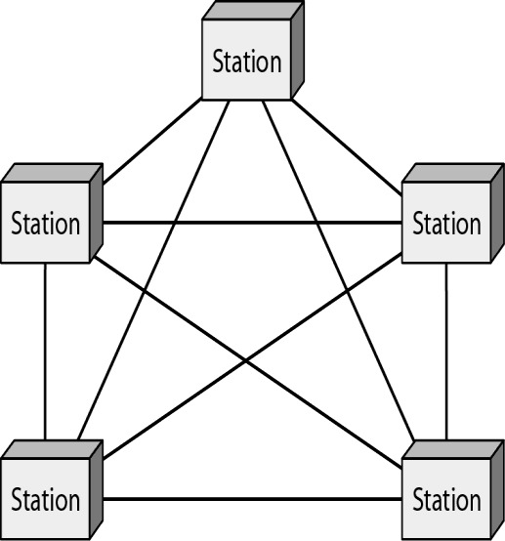








1. Mesh topology
To connect n number of nodes
Each node must be connected to n – 1 nodes.
We need n ( n - 1) / 2 duplex-mode links.
To accommodate that many links, every device must have n – 1 input/output (I/O) ports to be connected to the other n – 1 stations.
Example:
8 devices in mesh.
Number of links = 8 (8-1)/2 = 28
Number of ports per device = 8 –1 = 7

Slide 22
1. Mesh topology cont..
Advantages:
Eliminate the traffic problems
Each connection can carry its own data load.
It is robust.
If one link becomes unusable, it does not weaken the entire
system.
There is privacy or security
Only the intended recipient sees the message.
Prevent other users from gaining access to messages.
Links make fault identification and fault isolation easy
Traffic can be routed to avoid links with suspected problems.
Network manager discover the exact location of fault and helps
in finding its cause and solution.

Slide 23
1. Mesh topology cont..
Disadvantage:
It is related to amount of cabling and number of I/O ports
required.
Installation and reconnection are difficult.
Bulk of the wiring (in walls, ceilings, or floors) can be
greater than the available space.
Hardware (I/O ports and cable) can be expensive.
For these reasons it is implemented in a limited fashion.

Slide 24
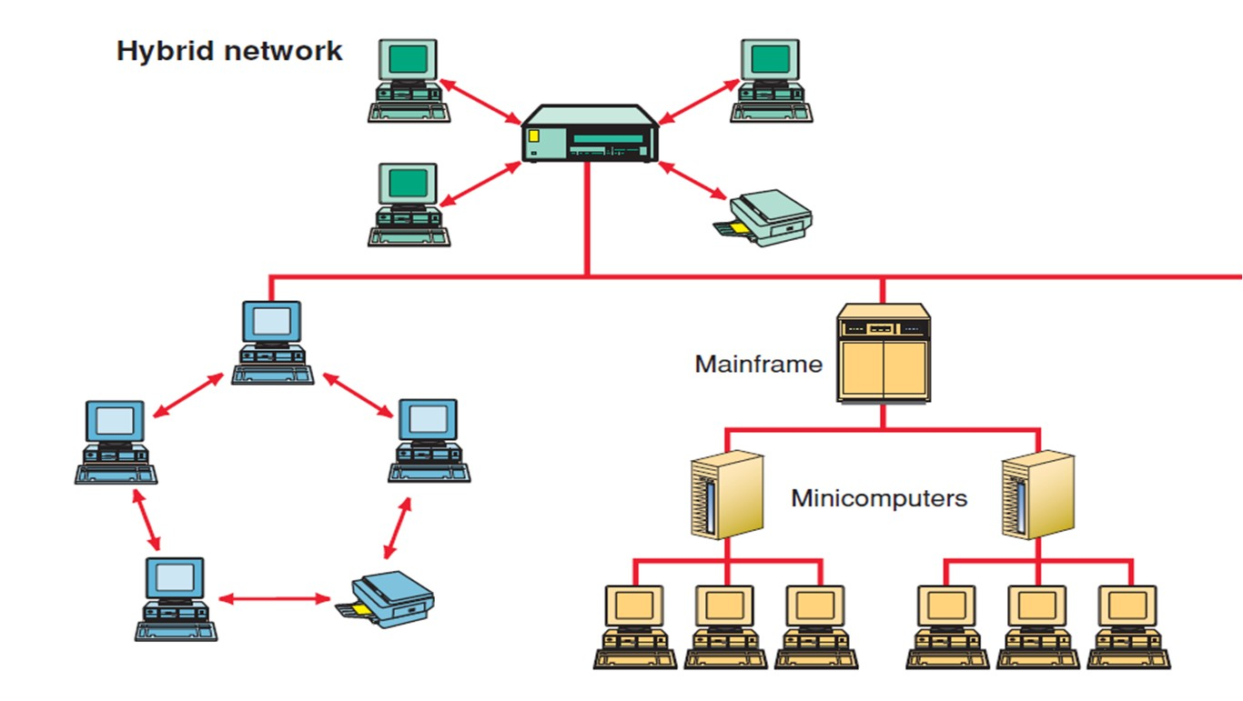
1. Mesh topology cont..
Ex: used as a backbone connecting the main computers of a
hybrid network that can include several other topologies.

Slide 25
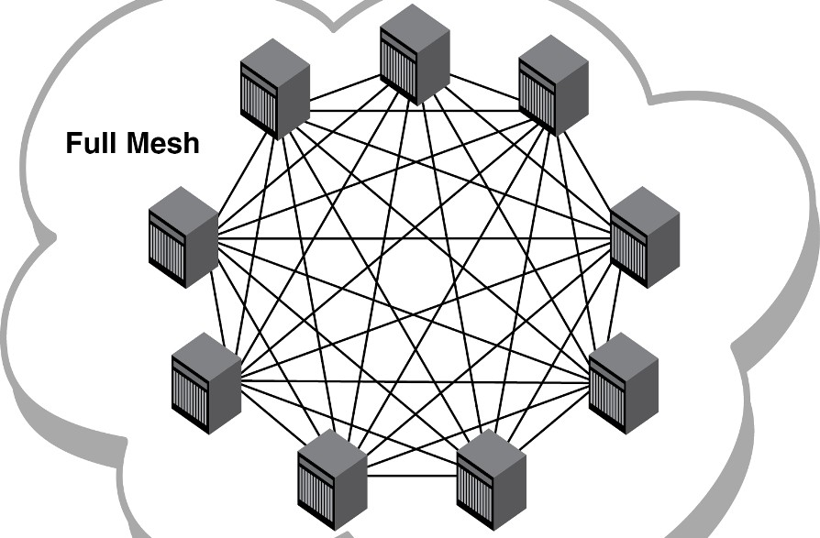
1. Mesh topology cont..
Ex: Connection of telephone regional offices
– In which each regional office needs to be connected to every other regional office.

Slide 26
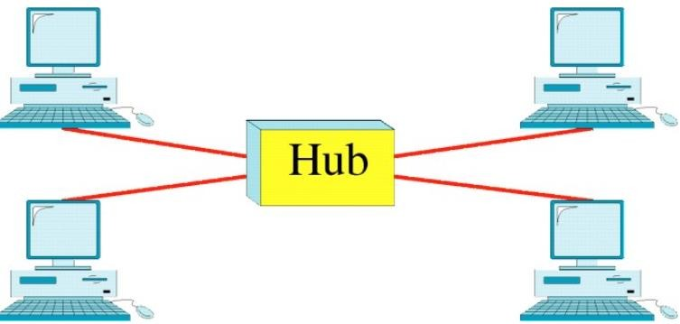
2. Star Topology
Each device has a dedicated point-to-point link only to a central
controller (hub).
No direct link between the devices.
It does not allow direct traffic between devices.
Controller acts as an exchange: If one device wants to send data to another, it sends the data to the controller, which then relays the data to the other connected device.

Slide 27
2. Star Topology cont..
Advantages:
It is less expensive than a mesh topology.
Each device needs only one link and one I/O port.
It is easy to install and reconfigure.
Far less cabling needs to be housed.
Easy to setup and modify (Additions, moves, and deletions required
one connection between that device and the hub).
It is robust
– If one link fails, only that link is affected. All other links remain
active.
Easy fault identification and fault isolation.
Hub can be used to monitor link problems and bypass defective links.

Slide 28
2. Star Topology cont..
Disadvantage
If the hub goes down, the whole system is dead.
More cabling is required than ring or bus topologies.
Example:
Used in LANs
Often used in High-speed LANs.
n devices are connected using ‘n’ links.
4 devices are connected using ‘4’ links.

Slide 29
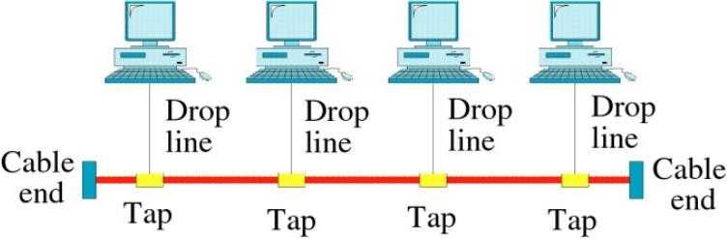
3. Bus Topology
Multipoint configuration.
One long cable acts as a backbone to link all devices in a network.
Nodes are connected to the bus cable by drop lines and taps.
As a signal travels along the backbone, some of its energy is transformed into heat. Therefore, it becomes weaker and weaker as it travels farther and farther.
For this reason there is a limit on the number of taps and on the
distance between those taps.

Slide 30
3. Bus Topology cont..
Advantages | Disadvantages
It is very simple to install. | It is very difficult to troubleshoot.
It uses less cable than other topologies. | It provides slow data transfer speed.
It is relatively inexpensive. | A single fault can bring the entire network down.
Used in small networks. | Difficult to add new devices. Require modification or replacement of the backbone.
It is easy to understand.

Slide 31
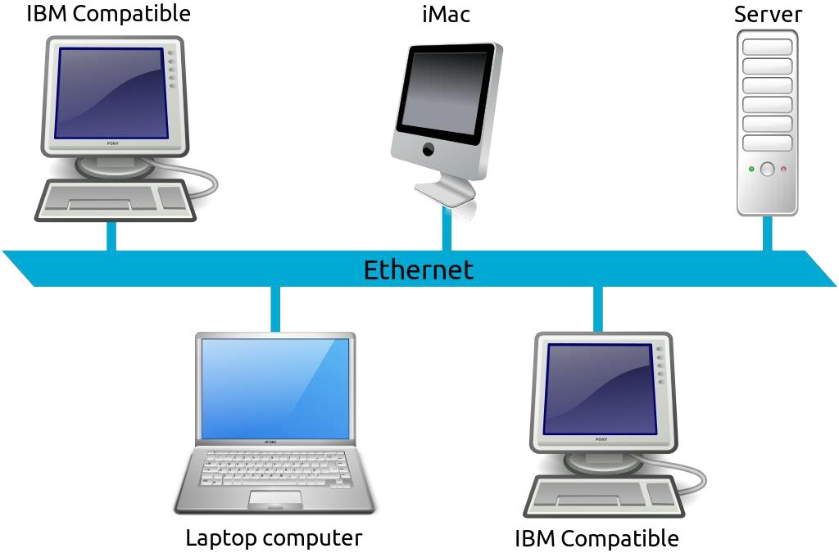
3. Bus Topology cont..
It is the one of the first topologies used in the design of early
local area networks.
Traditional Ethernet LANs use this topology.

Slide 32
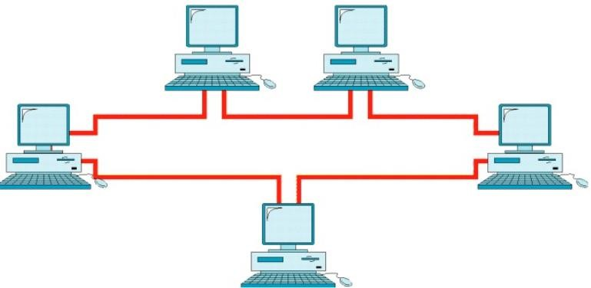
4. Ring Topology
Each device has a dedicated point-to-point configuration to
neighbors.
Signal is passed from device to device until it reaches
destination.
Signal is passed in one direction only.
Each device in the ring incorporates a repeater.
Repeater regenerates the bits and pass.

Slide 33
4. Ring Topology cont..
Advantages
Easy of install and reconfigure
Each device is linked (either physically or logically) to
only its immediate neighbors.
To add or delete a device – change only two connections.
Fault isolation is simple.
A signal is circulating at all times.
If one device does not receive a signal within a specified
period, it can issue an alarm.
Alarm alerts the network operator to the problem and its location.

Slide 34
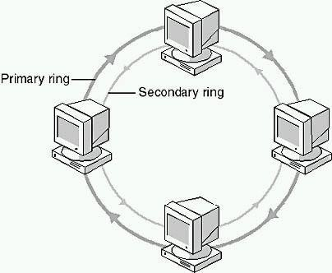
4. Ring Topology cont..
Disadvantage
Unidirectional traffic
A break in the ring can disable the entire network.
This weakness can be solved by using a dual ring or a switch
capable of closing off the break.
Secondary ring is redundant.
It is used as a backup in case the
primary ring fails.

Slide 35
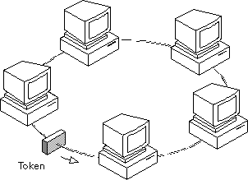
4. Ring Topology cont..
Ex: IBM introduced its Token-Ring local area network (LAN)

